Slide 1
Circuit Card Inquiry – RBT 125 Final
How a FET Switch Works
Tyler Widener

Slide 2
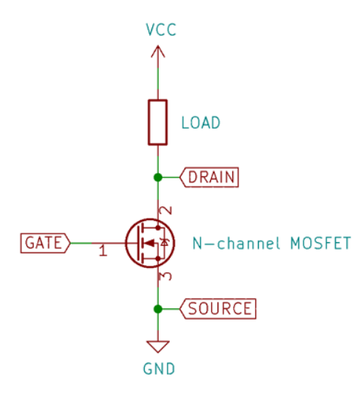
How a FET Switch Works:
A MOSFET works much like a transistor. This circuit allows a separate signal to open a electronic switch.
https://circuitdigest.com/electronic-circuits/simple-mosfet-switching-circuit-how-to-turn-on-turn-off-mosfets
Notes:
A MOSFET works a lot like a transistor. It has three pins; gate, drain, and source. Source and drain are both connected to the circuit instead of how an ordinary switch would be wired. Gate is a separate wire that uses an electronic signal to open and close the MOSFET. If the Gate pin is supplied with voltage, the MOSFET switch will close and current will flow through the circuit. If the Gate pin is not supplying any voltage, the MOSFET switch will remain open and current will not flow through the circuit. However, a resistor must still be connected to ground here, because otherwise the connection from gate to source will be a short. Sometimes, if an inductive device is attached like a solenoid, then a diode is required to ensure proper current flow, or the MOSFET will short itself. The difference between a MOSFET and a transistor is that MOSFETs are made with capacitors, which help it keep a stable voltage flow.

Slide 3
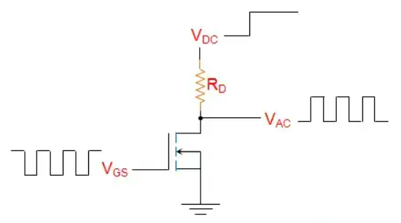
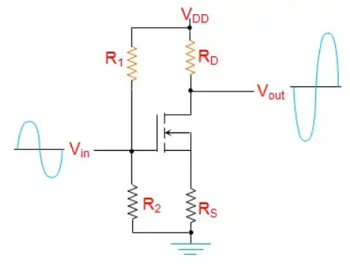
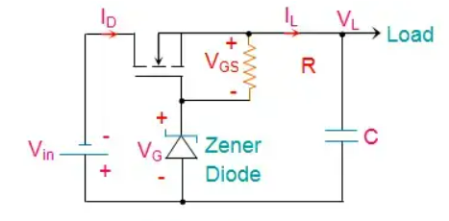
Applications
Chopper DC->AC
Amplifier
Regulator
https://www.electrical4u.com/applications-of-mosfet/
Notes:
A MOSFET has many applications in the real world. With a simple circuit, it can convert a DC voltage to an AC voltage, which is useful in things like transformers or power adapters people use for charging their phones every day. Then there are amplifiers, which can be used a number of different ways. MOSFETs can boost radio signals, allowing users to extend radio signals exponentially. MOSFETs also allow limited capability to boost power to a circuit, if used correctly. Then there are voltage regulators, which use MOSFETs to smooth out voltage signals to provide a consistent and steady signals. MOSFETs can switch extraordinarily fast, which makes them great for high-frequency applications. They can also handle high voltage and amperage, making them great for high power applications as well. All this adds up to MOSFETs being used practically everywhere, but they are more prevalent in the automotive and communication industries.

Slide 4
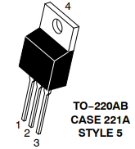
Advantages of a MOSFET
Versatile
High Switching Speed
High Power Capabilities
Low Power Consumption
Simple Component
https://www.onsemi.com/pdf/datasheet/ntb5860nl-d.pdf
Notes:
MOSFETs have a ton of advantages. They are extremely versatile, which means they can be used in a wide variety of scenarios and circuits. Due to their high switching speed, they can be used in a lot of high frequency applications. Some examples of this are radios and microprocessors. With it’s high-power capabilities, it can be used to monitor high voltages that are used even in wall outlets. This means they can be used in power transformers and AC adapters. It also consumes very little power, meaning it also is useful for the small stuff in various microprocessor circuits. Finally, it is a very simple component, which means that it is very cost-effective, making it easy to include a lot of them in electronic devices without making the price absurd.

Slide 5
Disadvantages of a MOSFET
Not many Disadvantages.
Always requires extra components to use fully, but so do most other components.
https://www.onsemi.com/pdf/datasheet/ntb5860nl-d.pdf
Notes:
MOSFETs do not have very many disadvantages. The only major disadvantage of a MOSFET is that it always requires extra components to use. That component could be as simple as just a protective resistor to prevent a short. If the load in the circuit is inductive, it could be a diode to prevent the MOSFET from switching voltage direction. Or it could be more complex, like the amplifier circuits shown previously. Even so, they still are relatively simple circuits, so costs are kept to a minimum, and they aren’t hard to manufacture either. MOSFETs are just all around fantastic pieces of hardware!

Slide 6
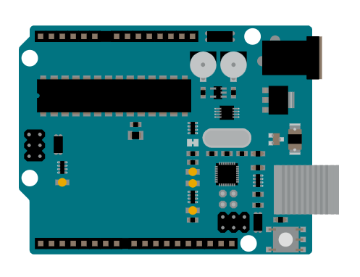
Variations
A popular variation of this circuit is to use the Arduino as a trigger.
This allows for the Arduino to safely control high voltages.
https://docs.arduino.cc/hardware/uno-rev3
Notes:
As for different variations of the MOSFET switch circuit, a popular variation involves using an Arduino as a trigger. The Arduino’s digital pins are able to output enough voltage to trigger a MOSFET’s gate, which often only requires a few volts. This allows the Arduino to control high voltages safely, since the microprocessor cannot handle more than 5 volts without being destroyed. I have actually used this exact variation in a past project; one of my Nerf blasters, the Meteor 3800 V3. The blaster utilizes flywheels and a solenoid to fire darts, which of course required some finer control, which meant an Arduino was perfect for the job. However, the Arduino cannot output nearly enough voltage to run a 12-volt solenoid. So, I wired a MOSFET as a switch, with an Arduino Nano’s digital pin attached to the gate of the MOSFET. This makes it easy for me to control the solenoid with the Arduino, as it is as simple as turning the digital pin on and off. There are many more variations of the MOSFET switch, like a voltage amplifier, using a P-channel MOSFET, and more!

Slide 7
References
Electronics Tutorials. (2023). MOSFET As A Switch. Retrieved 12/12/2023, from https://www.electronics-tutorials.ws/transistor/tran_7.html
Vivekanand. (March 22, 2021). Simple MOSFET Switching Circuit. Circuit Digest. Retrieved 12/12/2023, from https://circuitdigest.com/electronic-circuits/simple-mosfet-switching-circuit-how-to-turn-on-turn-off-mosfets
On Semiconductor. (August, 2012). NTB5860NL – N-Channel Power MOSFET. Retrieved 12/12/2023, from https://www.onsemi.com/pdf/datasheet/ntb5860nl-d.pdf
Electrical4U. (June 19, 2023). Applications of MOSFET: How They Work and Where They are Used. Retrieved 12/12/2023, from https://www.electrical4u.com/applications-of-mosfet/
Arduino Team. (2023). Arduino UNO R3 Documentation. Retrieved 12/12/2023, from https://docs.arduino.cc/hardware/uno-rev3

